Slide 1
Virtual Desktops on Azure
Azure Virtual Desktop and Horizon Cloud on Azure
https://github.com/argiesen/CloudVDI/

Slide 2
whoami: Andy Giesen
Grew up in Missoula, MT
Started building computers at age 6
15 years in the industry
Route/switch/wireless
Datacenter
Microsoft infrastructure and collab

Slide 3



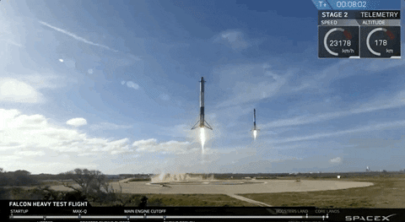
whoami
I enjoy…
learning about almost anything,
reading non-fiction,
writing PowerShell,
and geeking out over space stuff.
Notes:
https://www.youtube.com/watch?v=A0FZIwabctw
https://www.youtube.com/watch?v=ImoQqNyRL8Y

Slide 4
Azure Fundamentals
Structure/Hierarchy
Governance
Regions
Azure Active Directory
Network
Storage
Compute

Slide 5
Azure Tenant/Azure Active Directory
Azure Tenant – Container representing the whole organization
Azure Active Directory – Identity directory for the organization
Terms often used interchangeably
Notes:
https://docs.microsoft.com/en-us/azure/active-directory/fundamentals/active-directory-whatis#:~:text=Azure%20tenant,tenant%20represents%20a%20single%20organization.

Slide 6
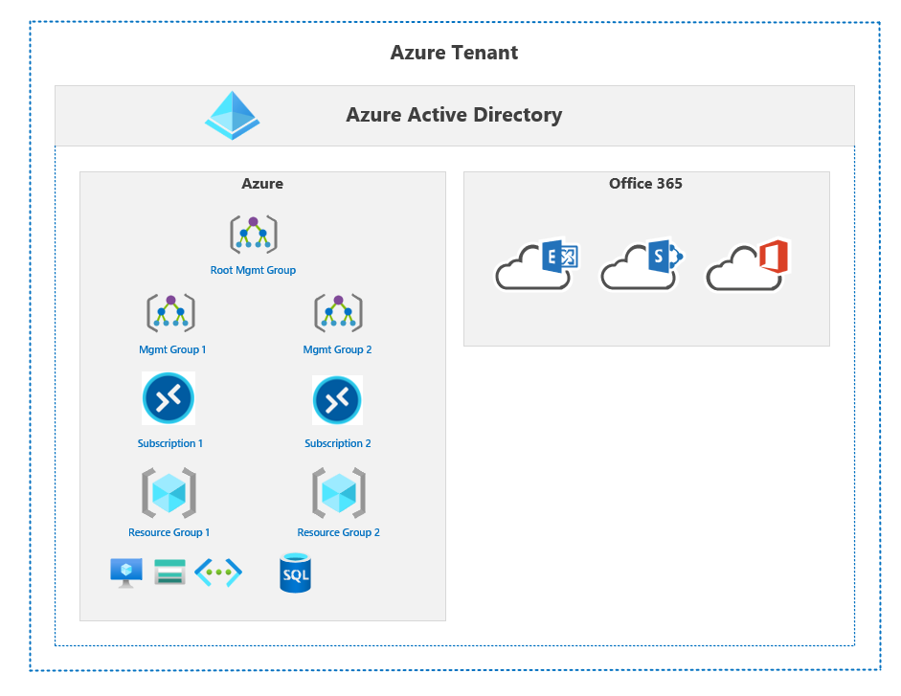
Structure/Hierarchy
Azure Tenant
Azure Active Directory
Management groups
Subscriptions
Resource groups
Resources
Administrative boundaries; Not a technical boundaries

Slide 7
Governance
Management Group and Subscription Organization
Naming
Tagging
Policies
Definitions
Initiatives
Infrastructure As Code
Blueprints
Terraform
Notes:
Azure Policy
https://docs.microsoft.com/en-us/azure/governance/azure-management
https://docs.microsoft.com/en-us/azure/governance/policy/overview
https://docs.microsoft.com/en-us/azure/governance/policy/concepts/effects
Tagging
https://docs.microsoft.com/en-us/azure/cloud-adoption-framework/decision-guides/resource-tagging/

Slide 8
Management Groups
Hierarchical structure that folds up to root management group
Up to 6 levels deep
Azure subscriptions are placed under management groups
Use cases:
Permission scoping
Policy scoping
Organizing environments (Prod/Dev)
Organizing business units
Optional
Notes:
https://docs.microsoft.com/en-us/azure/governance/management-groups/overview

Slide 9
Subscriptions
Types
Pay-As-You-Go (PAYG)
Cloud Solution Provider (CSP)
Enterprise Agreement
Billing boundary
Can be used to scope policies and permissions
Attach to Azure AD directory
Azure AD directory can have many subscriptions
Subscriptions can only be attached to one Azure AD
Resource quotas that must be manually increased when adding large numbers of resources
Notes:
https://docs.microsoft.com/en-us/azure/cloud-adoption-framework/decision-guides/subscriptions/

Slide 10
Resource Group
Logical, non-hierarchical, administrative container
Resources are only a member of one resource group at a time
Use for organizing resources that share a lifecycle
Notes:
https://docs.microsoft.com/en-us/azure/azure-resource-manager/management/manage-resource-groups-portal#what-is-a-resource-group

Slide 11
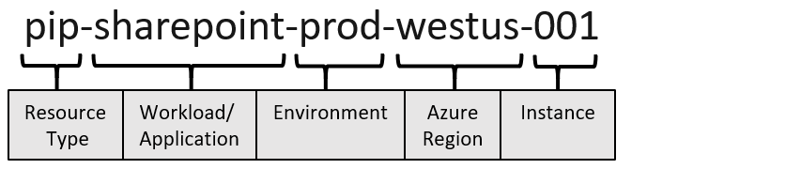
Naming
VNET: vnet-production01-prod-wus2
SNET: sent-servers01-prod-wus2
NSG: nsg-servers01-prod-wus2
Storage Account: stfiles01prodwus2
VM: azdc01
Notes:
https://docs.microsoft.com/en-us/azure/cloud-adoption-framework/ready/azure-best-practices/resource-naming
https://docs.microsoft.com/en-us/azure/azure-resource-manager/management/resource-name-rules

Slide 12
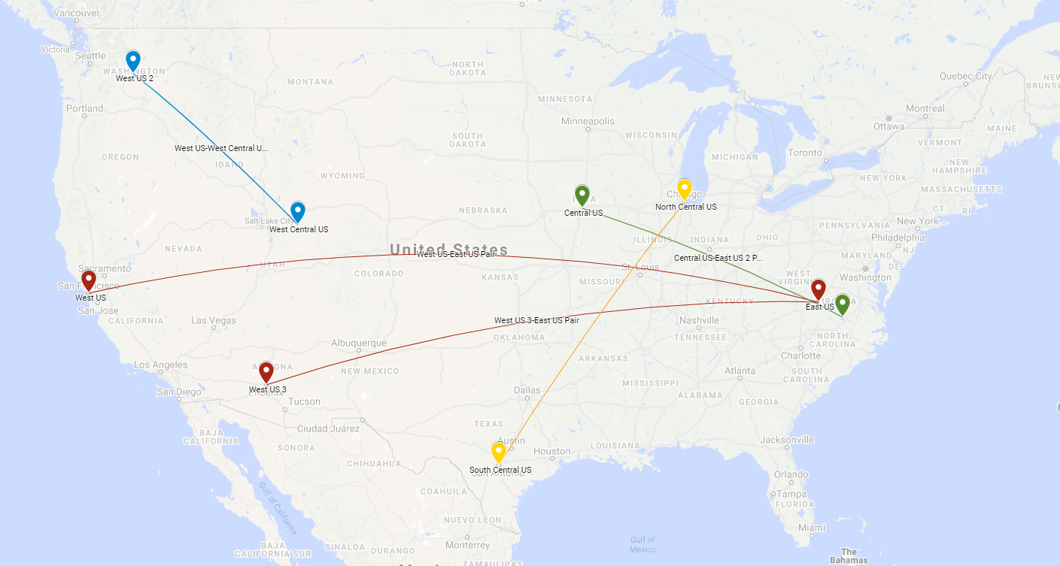
Regions
Notes:
https://docs.microsoft.com/en-us/azure/virtual-machines/regions
https://azure.microsoft.com/en-us/global-infrastructure/geographies/#geographies
https://azure.microsoft.com/en-us/global-infrastructure/services/
https://docs.microsoft.com/en-us/azure/cloud-adoption-framework/migrate/azure-best-practices/multiple-regions

Slide 13
Azure Active Directory
Non-regional
Not the same as Active Directory
Does not use legacy protocols (NTLM, Kerberos*, LDAP)
Does not have group policy
Does not have organizational units
Modern protocols
OIDC
OAuth2
SAML
WS-FED
REST
Notes:
https://docs.microsoft.com/en-us/azure/active-directory/fundamentals/active-directory-whatis
https://www.youtube.com/watch?v=EUVKEhiHYG0
https://www.youtube.com/watch?v=uts0oy8NlUs

Slide 14
Azure Active Directory
One Azure AD directory per tenant
Naming: <tenantName>.onmicrosoft.com
Not a forest/child domain
Azure AD roles are separate from Azure subscription roles
Global Admin does not grant access to Azure subscriptions and vice versa
Can contain both cloud only and directory synced objects

Slide 15
Azure AD Connect
Sync objects from AD domain(s) to a single Azure AD tenant
Users
Groups
Devices
Active Directory is the source of truth
Deployed to Windows server, automatic updates
Syncs objects every 30 minutes, passwords every 2 minutes
Single active instance per tenant
Use Staging Mode for backup
Notes:
https://www.youtube.com/watch?v=9XBcc2b62Ys
https://www.youtube.com/watch?v=Ziw9MClUfkc

Slide 16
Azure AD Connect
Sync based on OU structure or group membership (for testing)
Authentication Methods
Password Hash Sync (PHS) (Recommended)
Passthrough Authentication (PTA)
Federation (AD FS)*
Users UPN suffix must be public domain and added to Azure AD
Use IdFix to check for potential sync issues
Notes:
https://docs.microsoft.com/en-us/azure/active-directory/hybrid/whatis-hybrid-identity
https://docs.microsoft.com/en-us/azure/active-directory/hybrid/choose-ad-authn

Slide 17
Network
Architectures
Single VNET
Hub and Spoke
Virtual WAN
WAN connectivity
S2S / P2S VPN
SDWAN
ExpressRoute
Azure Firewall / NVA
Azure Load Balancer
Notes:
https://docs.microsoft.com/en-us/azure/cloud-adoption-framework/ready/considerations/networking-options
Azure Virtual Network Overview
https://www.youtube.com/watch?v=7rzawA--r20
Azure Virtual WAN Overview
https://www.youtube.com/watch?v=f-GyAURZWzg
Azure Route Server Overview
https://www.youtube.com/watch?v=c1f4rmkrF6M
Azure Virtual Network and PaaS Network Controls
https://www.youtube.com/watch?v=MnARPRQ2kvk
Microsoft Azure Master Class Part 6 - Networking
https://www.youtube.com/watch?v=K8ePZdLfU7M

Slide 18
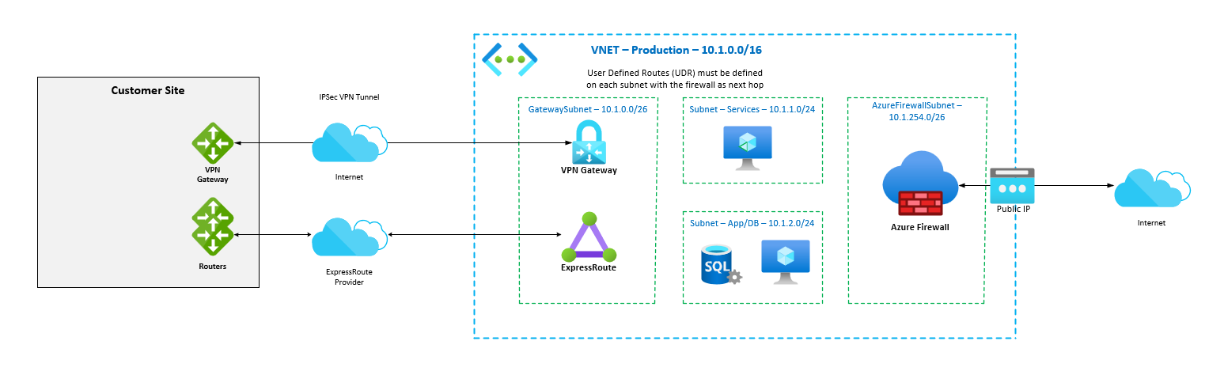
Single Virtual Network

Slide 19
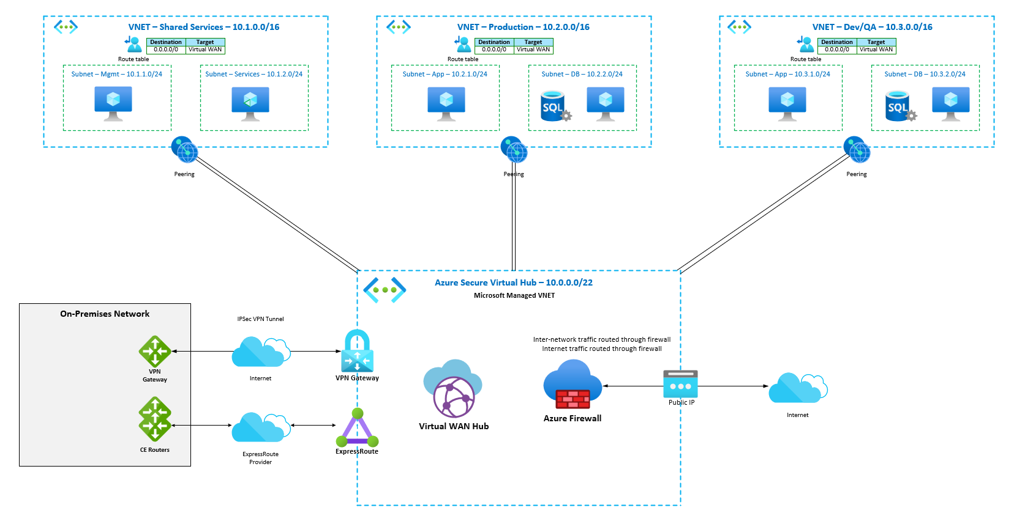
Hub and Spoke with Virtual WAN
Notes:
https://docs.microsoft.com/en-us/azure/architecture/networking/hub-spoke-vwan-architecture

Slide 20
WAN Connectivity
VPN Gateway
IPSec VPN
S2S and P2S options
Typically < 1Gbps
ExpressRoute
Managed connection (MPLS)
Interconnects through a provider
Requires redundant connections
50Mbps-10Gbps
Notes:
https://docs.microsoft.com/en-us/azure/vpn-gateway/vpn-gateway-about-vpngateways
https://docs.microsoft.com/en-au/azure/expressroute/expressroute-introduction
https://docs.microsoft.com/en-us/azure/architecture/reference-architectures/hybrid-networking/vnet-peering
ExpressRoute Deep Dive
https://www.youtube.com/watch?v=oevwZZ1YFS0

Slide 21
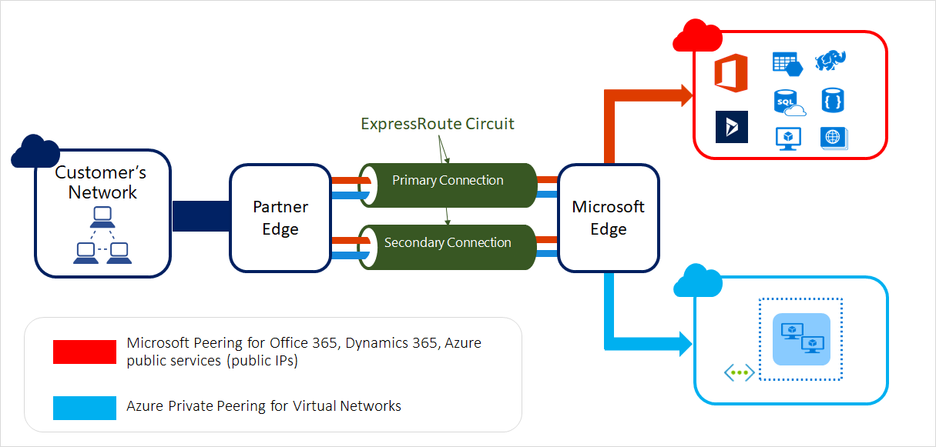
ExpressRoute

Slide 22
Network Security
Network Security Groups (NSG)
Basic L3/L4 ACL
Applied to network interface or subnet
Free
Azure Firewall / NVA
Standard L3/L4 and advanced L7 firewall features
Deployed into a subnet and routed through
Compute costs + Premium policies or 3rd party licensing
Notes:
https://docs.microsoft.com/en-us/azure/virtual-network/network-security-groups-overview
https://docs.microsoft.com/en-us/azure/virtual-network/network-security-group-how-it-works
https://docs.microsoft.com/en-us/azure/firewall/overview
Azure Firewall Deep Dive
https://www.youtube.com/watch?v=JiUerkqyW0g
Highly Available NVAs in Microsoft Azure
https://www.youtube.com/watch?v=LrshfXfz29Y

Slide 23
Azure Load Balancer
L4 load balancing
Outbound internet access (NAT)
Public or internal (private)
Basic and Standard tiers
Standard is secure by default and has an SLA of 4 9’s
Basic doesn’t support outbound rules or HTTPS probes
Basic is free
Notes:
https://docs.microsoft.com/en-us/azure/load-balancer/load-balancer-overview
https://docs.microsoft.com/en-us/azure/architecture/guide/technology-choices/load-balancing-overview
Azure Load Balancer Deep Dive
https://www.youtube.com/watch?v=wJvmXM81tEI
Picking the right Azure Load Balancing Solution
https://www.youtube.com/watch?v=s1H2HpSJ-cg

Slide 24
Network Gotchas
Internet traffic drops ICMP
Default gateway does not respond to ICMP
Ping a VM or address across VPN/ExpressRoute to test internal traffic
Use TCP connections to test internet traffic
Notes:
https://docs.microsoft.com/en-us/archive/blogs/mast/use-port-pings-instead-of-icmp-to-test-azure-vm-connectivity

Slide 25
Storage
Services
Blob (Object storage)
File (SMB)
Types
Standard
Premium
NetApp Files
Connectivity
Public (Internet)
Private (VNET integrated)
Notes:
https://docs.microsoft.com/en-us/azure/storage/common/storage-account-overview
https://docs.microsoft.com/en-us/azure/storage/common/storage-network-security

Slide 26
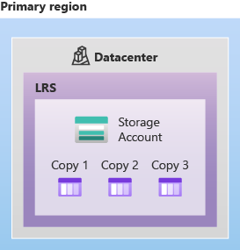
Locally Redundant Storage (LRS)
Three copies of data in single data center
Annual SLA of 11 9’s
Synchronous writes
Could be lost in DC loss
Notes:
https://docs.microsoft.com/en-us/azure/storage/common/storage-redundancy#locally-redundant-storage

Slide 27
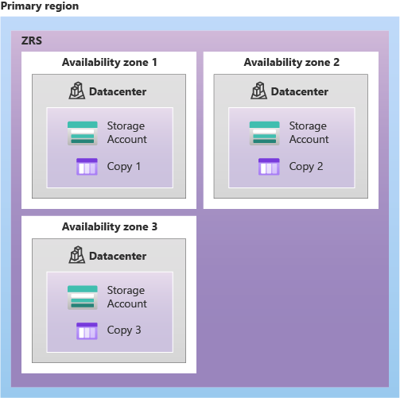
Zone-Redundant Storage (ZRS)
Three copies across three Availability Zones
Availability Zones are separate physical locations with independent power, cooling, and networking
Annual SLA of 12 9’s
Synchronous writes
Not available in all regions, resources, or tiers
Notes:
https://docs.microsoft.com/en-us/azure/storage/common/storage-redundancy#zone-redundant-storage

Slide 28
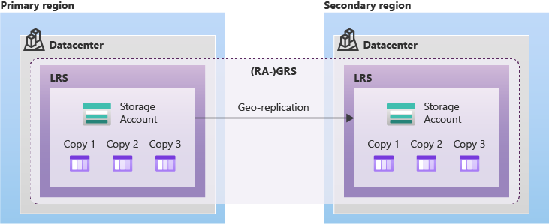
Geo-Redundant Storage (GRS)
Three synchronous copies in single data center (LRS)
Three asynchronous copies to secondary region
Secondary region is defined region pair
Annual SLA of 16 9’s
Notes:
https://docs.microsoft.com/en-us/azure/storage/common/storage-redundancy#geo-redundant-storage
https://docs.microsoft.com/en-us/azure/storage/common/storage-disaster-recovery-guidance

Slide 29
Compute
Use Case | Series
General purpose | B and D series
Compute optimized | F and FX series
Memory optimized | E and M series
Storage optimized | L series
GPU | NC, ND, and NV series
High performance compute | H, HB, and HC series
D2v4
D-series VM
# of vCPUs
Version of family series (CPU generation)
D4asv5
a = AMD processor
s = Premium storage capable
Notes:
https://docs.microsoft.com/en-us/azure/virtual-machines/sizes
https://docs.microsoft.com/en-us/azure/virtual-machines/vm-naming-conventions

Slide 30
Azure Virtual Desktop
Architecture
Design
Deployment
Management
Windows 365
Notes:
https://docs.microsoft.com/en-us/azure/virtual-desktop/overview

Slide 31
Architecture and Design
Broker/Control Plane
Identity
Session Hosts, Sizing, and Pool Types
Pooled
Personal
Network connectivity
Profile management with FSLogix
Notes:
https://docs.microsoft.com/en-us/azure/architecture/example-scenario/wvd/windows-virtual-desktop

Slide 32
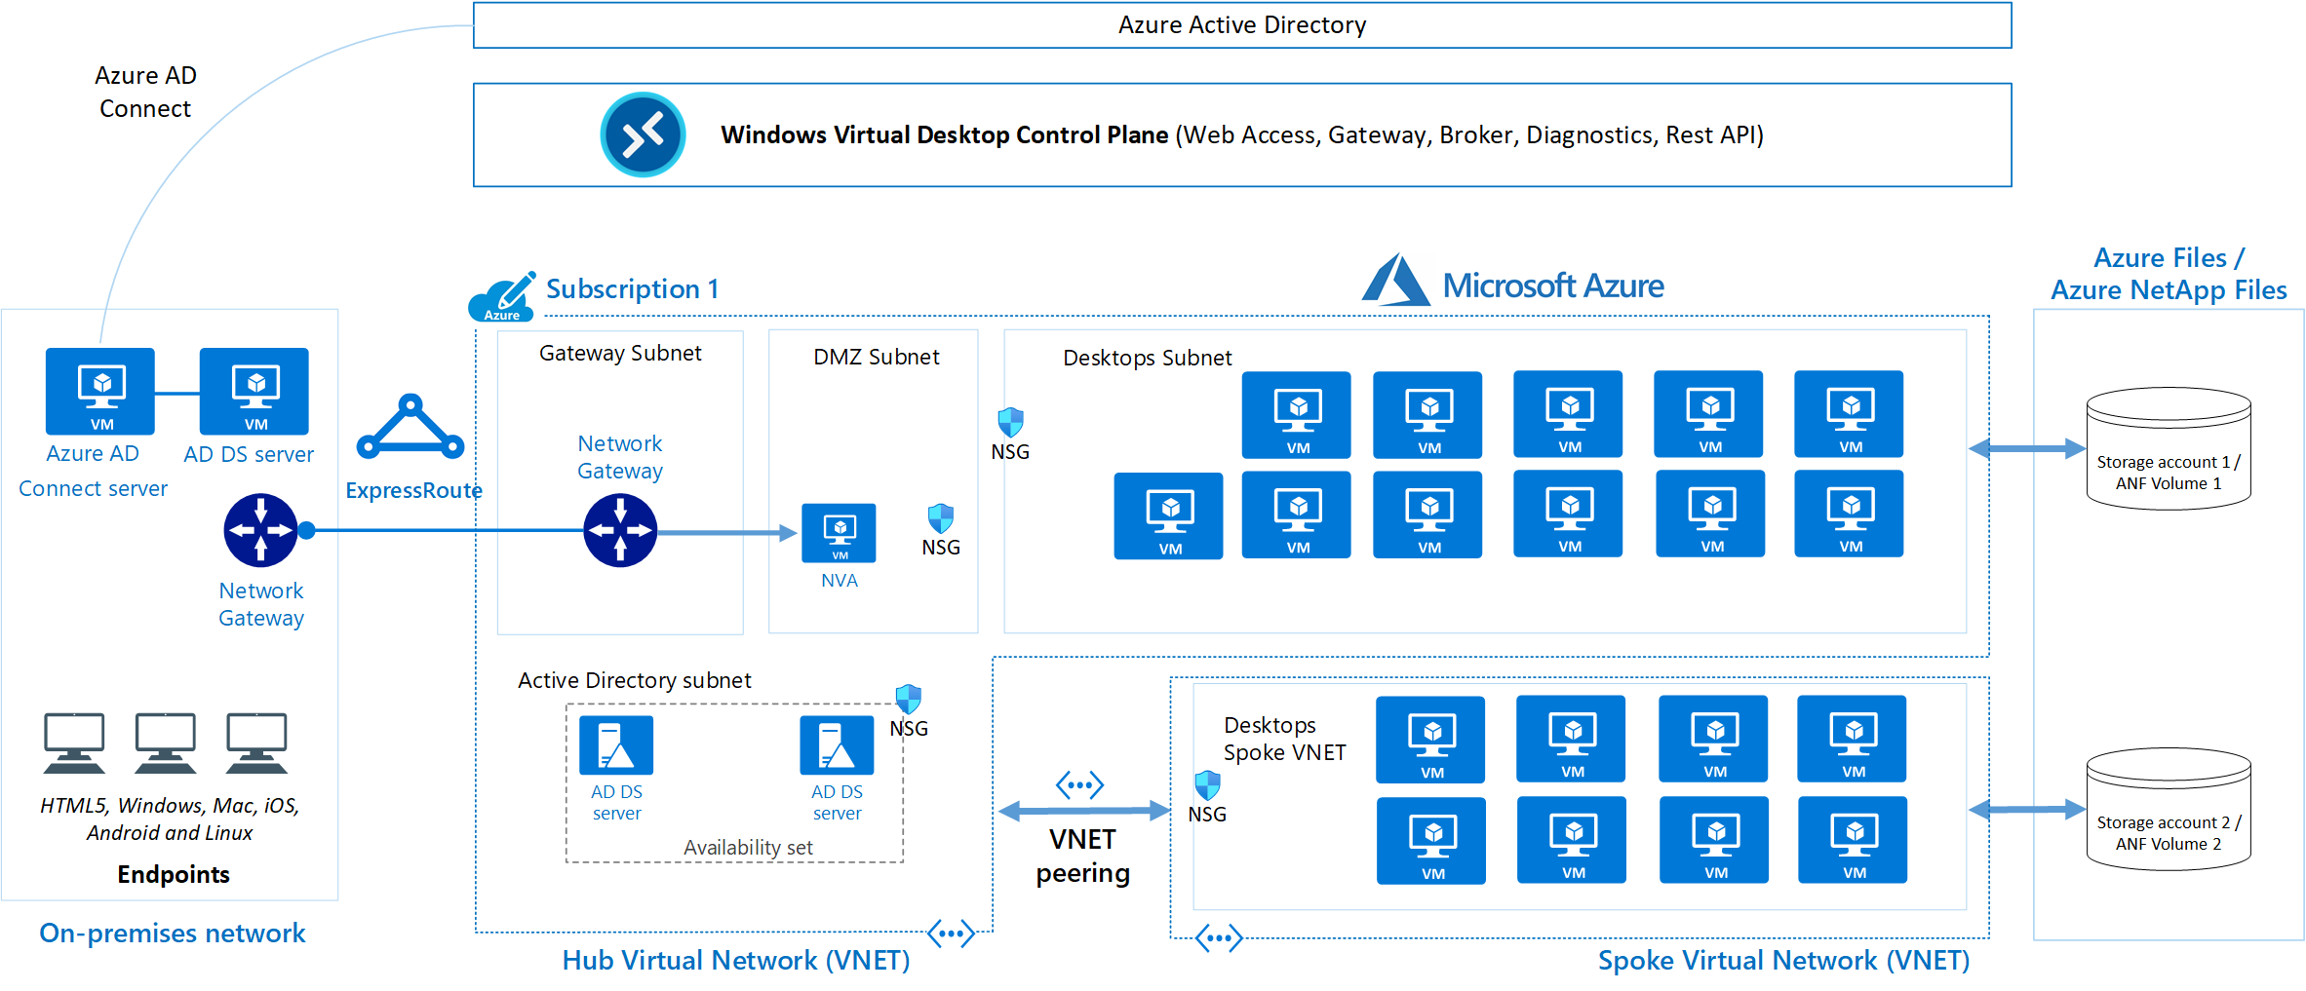
Architecture

Slide 33
Architecture – Logical Components
Control Plane/Broker – Global service
Session Host – Desktop virtual machine
Host Pool – Contains Session Hosts
Type: Pooled/Personal
Application Group
Type: Full desktop/RemoteApp
User assignments applied here
Tied to the host pool and workspace
Workspace – Presents Application Groups to users
Notes:
https://docs.microsoft.com/en-us/azure/virtual-desktop/environment-setup

Slide 34
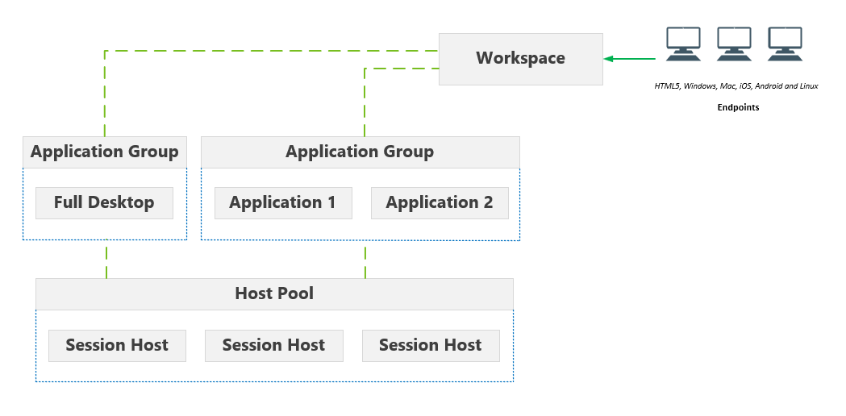
Architecture – Logical Components

Slide 35
Region
Validate resource availability in regions before deciding
Especially GPU backed compute SKUs
Resources may not be offered or are constrained
Network latency from clients is key
Notes:
https://www.azurespeed.com/Azure/Latency

Slide 36
Identity
Users and groups must be synced from on-premises AD
Application Group user assignment
File share permissions to domain joined storage accounts
Desktops must have line of sight to Active Directory
Recommend deploying DCs to Azure to minimize latency
AVD supports SSO using ADFS
Without SSO, two credential prompts: AVD then Windows
Notes:
https://docs.microsoft.com/en-us/azure/virtual-desktop/authentication
https://docs.microsoft.com/en-us/azure/virtual-desktop/configure-adfs-sso

Slide 37
Session Hosts and Pool Types
Pooled
Persistent, shared by multiple users similar to RDS
Should have profile management
Windows 10/11 multi-session image
Remote apps; Light or Medium user personas
Personal
Persistent, dedicated machine
Does not need profile management
Heavy or Power user personas

Slide 38
Pool load-balancing
Breadth-first – Optimize performance/user experience
Depth-first – Optimize cost
Scaling plans for auto-scaling (currently in preview)
Notes:
https://docs.microsoft.com/en-us/azure/virtual-desktop/host-pool-load-balancing
https://docs.microsoft.com/en-us/azure/virtual-desktop/autoscale-scaling-plan

Slide 39
Session Host Recommendations
D-series recommended for most scenarios
NV-series for graphics intensive workloads
NV and NVv3 use NVIDIA M60 GPU
NVv4 use AMD MI25 GPU
Check regional availability
B-series burstable VMs for users that don’t need maximum CPU performance
Recommend limiting vCPUs to between 4 and 24 (32 max)*
Diminishing returns past 24
*Single-session: 2 physical; 4 with hyperthreading
Premium SSD for OS disk
Notes:
https://docs.microsoft.com/en-us/windows-server/remote/remote-desktop-services/remote-desktop-workloads
https://docs.microsoft.com/en-us/windows-server/remote/remote-desktop-services/virtual-machine-recs
https://docs.microsoft.com/en-us/windows-server/remote/remote-desktop-services/rds-graphics-virtualization

Slide 40
Session Host Sizing – Multi-session
MULTI-SESSION RECOMMENDATIONS
Workload type | Maximum users per vCPU | vCPU/RAM/OS storage minimum | Example Azure instances | Profile container storage minimum
Light | 6 | 8 vCPUs, 16 GB RAM, 16 GB storage | D8s_v4, F8s_v2, D8as_v4, D16s_v4, F16s_v2, D16as_v4 | 30 GB
Medium | 4 | 8 vCPUs, 16 GB RAM, 32 GB storage | D8s_v4, F8s_v2, D8as_v4, D16s_v4, F16s_v2, D16as_v4 | 30 GB
Heavy | 2 | 8 vCPUs, 16 GB RAM, 32 GB storage | D8s_v4, F8s_v2, D8as_v4, D16s_v4, F16s_v2, D16as_v4 | 30 GB
Power | 1 | 6 vCPUs, 56 GB RAM, 340 GB storage | D8s_v4, F8s_v2, D8as_v4, D16s_v4, F16s_v2, D16as_v4, NV12, NVv4 | 30 GB
Notes:
https://docs.microsoft.com/en-us/windows-server/remote/remote-desktop-services/virtual-machine-recs
https://docs.microsoft.com/en-us/azure/virtual-machines/sizes

Slide 41
Session Host Sizing – Multi-session
D8v4 most common SKU for pooled VM
8-20 users per VM

Slide 42
Networking
Size subnet(s) according to number of desktops
Subnets for desktops only
Place the desktops as close to the users as possible
Lower latency produces better user experience
Recommend less than 150ms; 200ms max
Place desktops in a region with AVD control plane to avoid egress costs
For large deployments: Use RDP Shortpath & QoS with ExpressRoute for optimal on-premises user performance
Notes:
https://docs.microsoft.com/en-us/azure/virtual-desktop/network-connectivity
https://docs.microsoft.com/en-us/azure/virtual-desktop/connection-latency
https://docs.microsoft.com/en-us/azure/virtual-desktop/shortpath

Slide 43
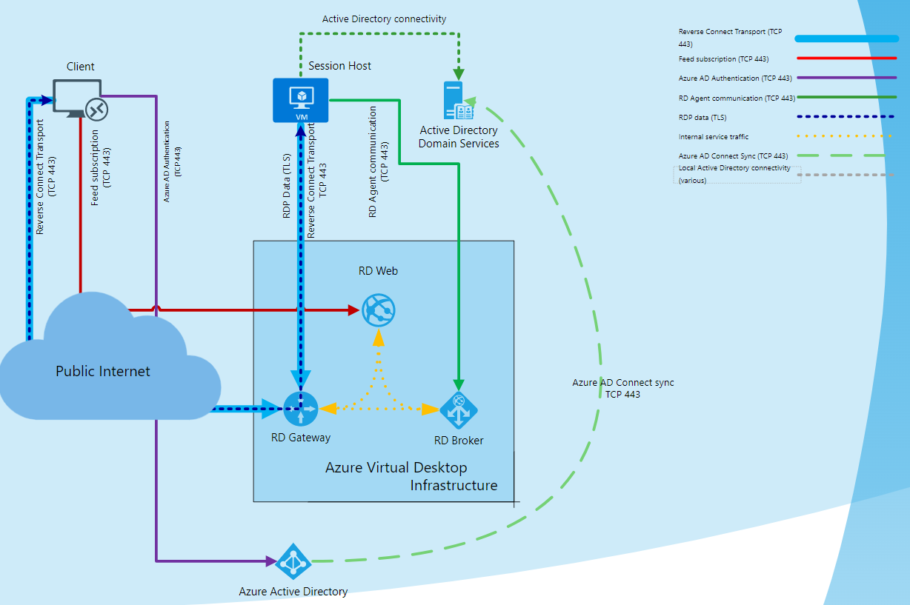

Slide 44
Network Bandwidth (One 1080p monitor)
Scenario | Default mode | H.264/AVC 444 mode
Idle | 0.3 Kbps | 0.3 Kbps
Microsoft Word | 100-150 Kbps | 200-300 Kbps
Microsoft Excel | 150-200 Kbps | 400-500 Kbps
Microsoft PowerPoint | 4-4.5 Mbps | 1.6-1.8 Mbps
Web Browsing | 6-6.5 Mbps | 0.9-1 Mbps
Image Gallery | 3.3-3.6 Mbps | 0.7-0.8 Mbps
Video playback | 8.5-9.5 Mbps | 2.5-2.8 Mbps
Fullscreen Video playback | 7.5-8.5 Mbps | 2.5-3.1 Mbps
Notes:
https://docs.microsoft.com/en-us/azure/virtual-desktop/rdp-bandwidth
https://docs.microsoft.com/en-us/windows-server/remote/remote-desktop-services/network-guidance

Slide 45
Profile management with FSLogix
Two types of containers
Profile container – Whole profile
Office container – Only Office files
These files are more of a cache
Can be used separately or together
Stored on SMB file share
Notes:
Calculator: https://github.com/RMITBLOG/FSLogix
https://docs.microsoft.com/en-us/azure/architecture/example-scenario/wvd/windows-virtual-desktop-fslogix
https://docs.microsoft.com/en-us/azure/virtual-desktop/fslogix-containers-azure-files

Slide 46
FSLogix Storage Capacity
Default FSLogix profile size: 30GB
Typical profile container size: 8GB
Shrinking profiles can be done with script during maintenance window

Slide 47
FSLogix Storage Performance (IOPS)
Profile | Steady State IOPS | Login IOPS
Low | ~10/user | ~15/user
Medium | ~15/user | ~25/user
High | ~20/user | ~50/user

Slide 48
FSLogix Storage Options
Azure Files (Recommended)
Premium storage recommended
Performance scales with capacity
Capacity is pre-provisioned increasing initial costs
Maximum 100,000 IOPS
Standard supported
Enable Large File Share option to overcome default 1,000 IOPS limit
Maximum 20,000 IOPS
Native backup with Azure Backup
Join to Active Directory for authentication
Notes:
https://docs.microsoft.com/en-us/azure/virtual-desktop/store-fslogix-profile

Slide 49
FSLogix Storage Options
Azure NetApp Files
Extreme performance
$$$
Windows Server with file share (Not recommended)
Because… why?

Slide 50
FSLogix Storage Recommendations
More than 200 users or medium workloads should use Premium file shares
Storage account in the same region as compute (Minimize latency)
One file share per host pool (Maximize IOPS)
Antivirus exclusions on client (and Windows Server file share)
Notes:
https://docs.microsoft.com/en-us/azure/architecture/example-scenario/wvd/windows-virtual-desktop-fslogix

Slide 51
Clients
Windows
Inbox (Remote Desktop App)
Desktop app
Microsoft Store
macOS
Android
iOS
Web
Thin clients
Notes:
https://docs.microsoft.com/en-us/windows-server/remote/remote-desktop-services/clients/remote-desktop-features
https://docs.microsoft.com/en-us/azure/virtual-desktop/user-documentation/connect-windows-7-10

Slide 52
Deployment
Sync identity
Deploy networking
Create OU, service accounts, groups, and GPOs
Deploy storage and domain join
Create golden image
Setup email discovery DNS
Create host pool, app group, and workspace
Assign users
Notes:
https://docs.microsoft.com/en-us/azure/virtual-desktop/create-file-share
https://docs.microsoft.com/en-us/windows-server/remote/remote-desktop-services/rds-email-discovery?context=/azure/virtual-desktop/context/context

Slide 53
Create OU, groups, and GPOs
OUs for computer accounts per region or host pool
User groups for user assignment
FSLogix GPO
VDI GPO

Slide 54
FSLogix GPO
VHDLocations: UNC path to Azure file share
Virtual Disk Type: VHDX
Size in MBs
Default is 30GB
Enable “Dynamic VHD(X) allocation”
Enable “Swap directory name component”
Enable “Delete local profile when FSLogix Profile should apply”*
*Be aware in existing environment, greenfield is recommended
Optionally: Enable Cloud Cache (instead of VHDLocations)

Slide 55
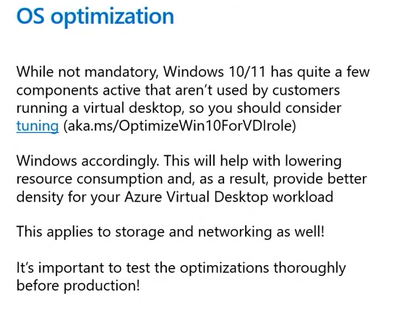
Golden Image
Create VM from Azure image gallery or uploaded VHDX
Install applications
Optimize with Virtual Desktop Optimization Tool (VDOT)
Snapshot for future updates, sysprep, capture (and delete)
If domain joining, do not put into OU with FSLogix GPO; Remove from domain before sysprep
Azure Image Builder with Azure DevOps available for automating image builds
Notes:
https://docs.microsoft.com/en-us/azure/virtual-desktop/set-up-golden-image
https://docs.microsoft.com/en-us/azure/virtual-machines/windows/image-builder-virtual-desktop
VDOT
https://techcommunity.microsoft.com/t5/azure-virtual-desktop/windows-virtual-desktop-optimization-tool-now-available/m-p/1558614
https://github.com/The-Virtual-Desktop-Team/Virtual-Desktop-Optimization-Tool
https://www.christiaanbrinkhoff.com/2020/07/31/optimize-your-windows-10-single-and-multi-session-images-with-the-new-windows-virtual-desktop-optimization-tool/

Slide 56
Management
Endpoint management with Intune
Application delivery with MSIX app attach
Monitoring with Azure Monitor
Deploy AVD Workbook
Notes:
https://docs.microsoft.com/en-us/azure/virtual-desktop/azure-monitor
Direct link to Workbook deployment: https://aka.ms/azmonwvdi
https://docs.microsoft.com/en-us/azure/virtual-desktop/what-is-app-attach

Slide 57
Backup and Disaster Recovery
Backup
Backup profiles with Azure Backup and make geo-redundant with GRS
Backup golden image
Generally, don’t backup session hosts
Disaster Recovery
Build AVD components in second region
Copy golden image and profiles to second region
Use ASR to failover session hosts during disaster

Slide 58
Windows 365
Notes:
https://docs.microsoft.com/en-us/azure/virtual-desktop/compare-virtual-desktop-windows-365

Slide 59
Windows 365

Slide 60
Windows 365

Slide 61
Windows 365

Slide 62
Horizon Cloud on Azure
Architecture and Design
Discovery
Requirements
Deployment
Management
Not covering profile management, app layering, etc.
Notes:
https://www.youtube.com/watch?v=qIWum9JtLHk

Slide 63
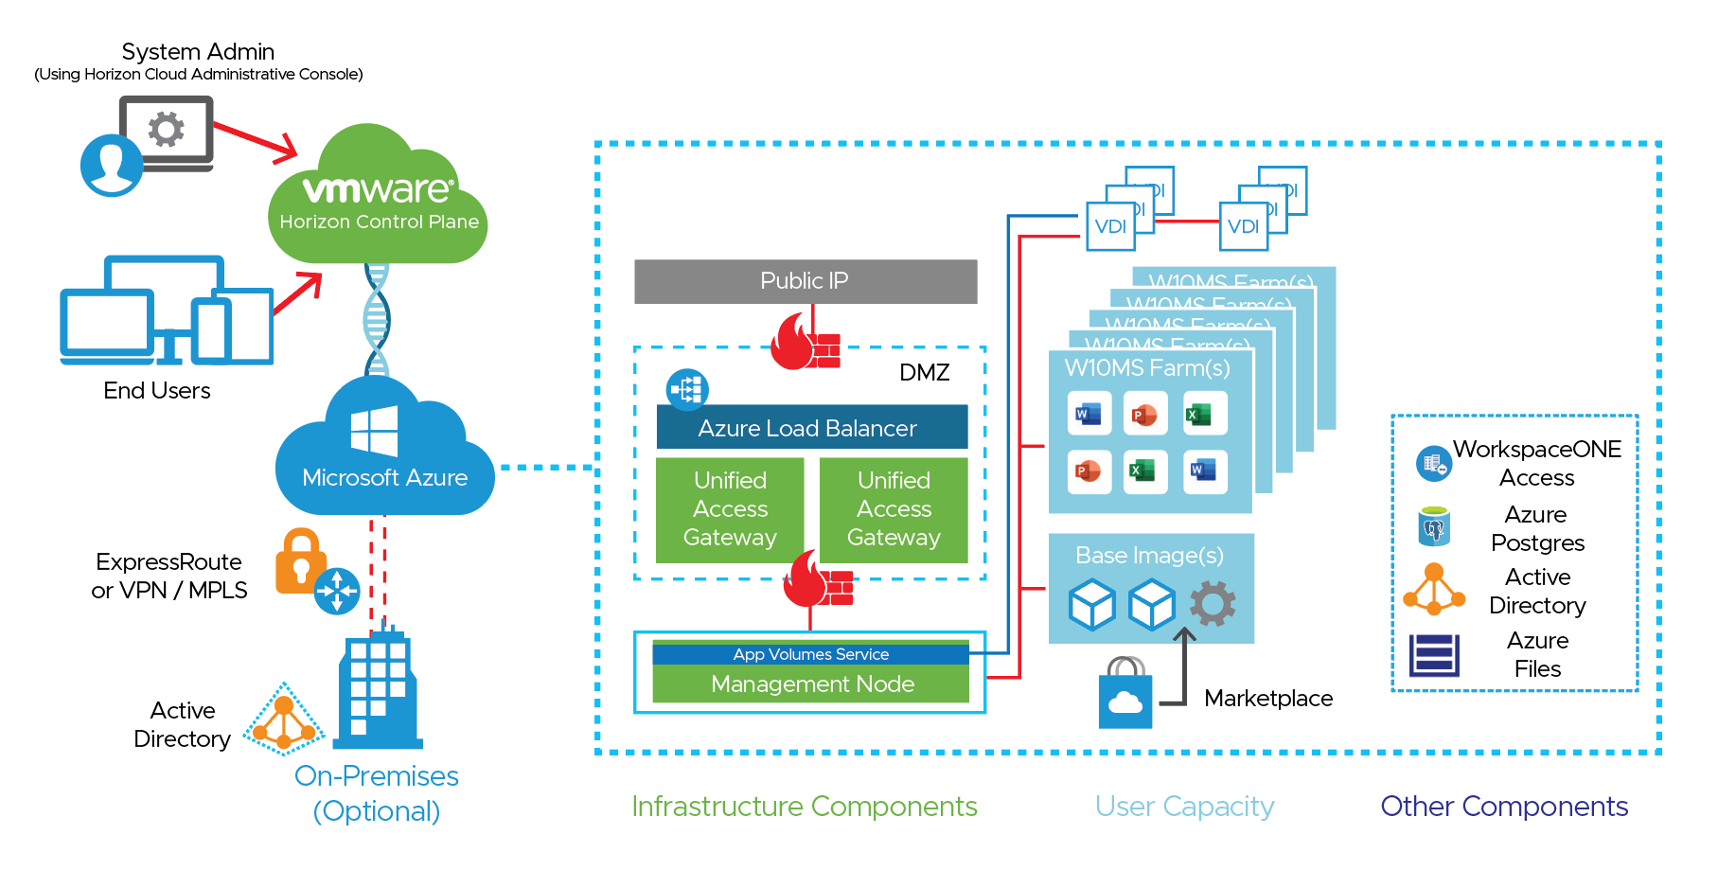
Architecture

Slide 64
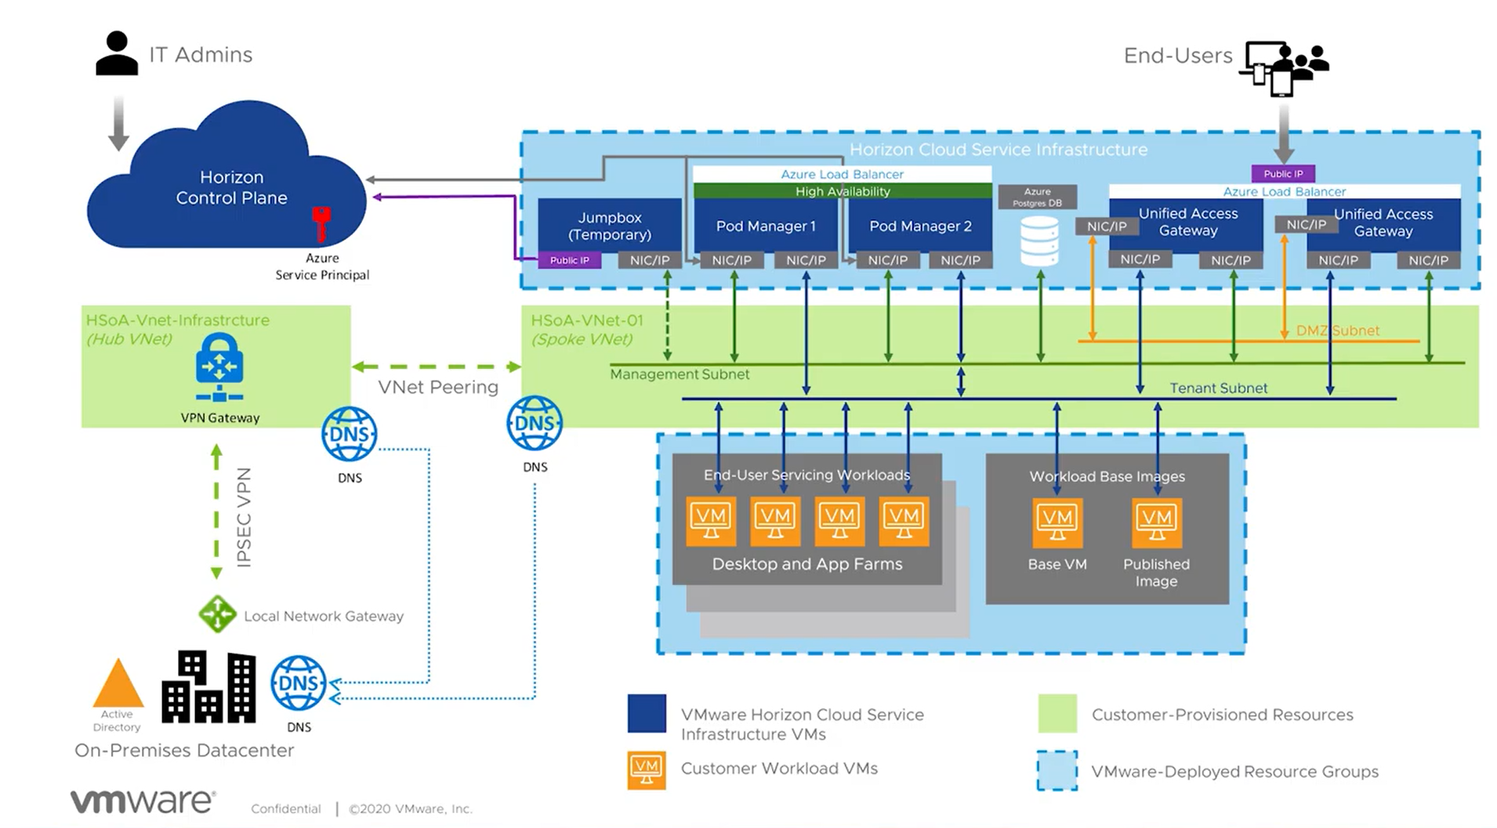

Slide 65
Components
Pod Manager (“SmartNode”)
Jump Box (Temporary Pod Deployment Engine)
Unified Access Gateways (UAG)
Maintenance (Image management)
Desktops

Slide 66
Azure Networking
Deploy dedicated VNET(s) for Horizon Cloud Pod
No other resources may be attached
Peer with hub VNET
Two VNET options
External gateway in same VNET as pod
External gateway in separate VNET (and subscription) as pod
Subnet sizing
How many desktops?
Is HA required?
Internal DNS servers for VNET
Notes:
https://docs.vmware.com/en/VMware-Horizon-Cloud-Service/services/hzncloudmsazure.getstarted15/GUID-919E6477-7506-46CF-B8BC-D4D47A4CC301.html
https://docs.vmware.com/en/VMware-Horizon-Cloud-Service/services/hzncloudmsazure.getstarted15/GUID-78D3FAFF-50A5-49F6-B367-150A57BA9B24.html#GUID-78D3FAFF-50A5-49F6-B367-150A57BA9B24
https://docs.vmware.com/en/VMware-Horizon-Cloud-Service/services/hzncloudmsazure.getstarted15/GUID-DFD535B0-CA08-444C-86BB-638BE61876CF.html
https://docs.vmware.com/en/VMware-Horizon-Cloud-Service/services/hzncloudmsazure.getstarted15/GUID-E3B769E7-BB17-40FD-9CAB-111B348C767E.html#GUID-E3B769E7-BB17-40FD-9CAB-111B348C767E

Slide 67
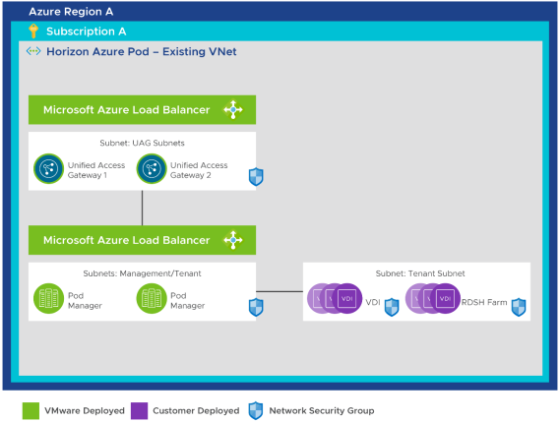
Single VNET
Same VNET as pod
Subnets
Mgmt subnet – /27 min.
Primary VM subnet – /27 min.
/24 - /21 recommended
DMZ subnet – /28 min.
Notes:
https://techzone.vmware.com/resource/horizon-cloud-on-microsoft-azure-architecture#network-design

Slide 68
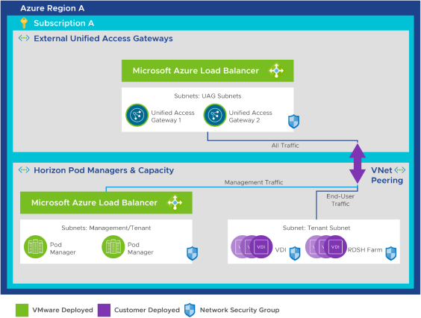
Separate UAG VNET
Separate VNET as pod
Subnets
Pod VNET (VNET-1)
Mgmt subnet – /27 min.
Primary VM subnet – /27 min.
/24 to /21 preferred
Gateway VNET (VNET-2)
Mgmt subnet – /27 min.
Back-end subnet – /27 min.
/24 to /22 preferred
Front-end DMZ subnet – /28 min.
Notes:
https://techzone.vmware.com/resource/horizon-cloud-on-microsoft-azure-architecture#deploying-unified-access-gateways-into-a-different-vnet

Slide 69
Azure Subscription Considerations
Ensure that there are no Azure policies to the subscription that may prevent deployment
Contributor rights must be granted to app on the subscription
Quota increase

Slide 70
Azure Subscription Quotas - Infrastructure
Do the math for each SKU, then double it for upgrades
Jump Box – 1 x F2 (2vCPU)
Pod/Pod Manager w/ HA – 2 x D4v3 (4vCPU)
Pod/Pod Manager w/o HA – 1 x D4v3 (4vCPU)
External UAG – 2 x A4v2 (4vCPU) or 2 x F8sv2 (8vCPU)
Internal UAG – 2 x A4v2 (4vCPU) or 2 x F8sv2 (8vCPU)
PostgreSQL Service – Gen 5, Mem Optimized, 2 vCores, 10GB storage
Notes:
Microsoft Azure Virtual Machine Requirements for a Horizon Cloud Pod in Microsoft Azure
https://docs.vmware.com/en/VMware-Horizon-Cloud-Service/services/hzncloudmsazure.getstarted15/GUID-BA0CD5F3-4805-4C21-866F-93CCC9976EDC.html
https://docs.vmware.com/en/VMware-Horizon-Cloud-Service/services/hzncloudmsazure.getstarted15/GUID-5F69086E-E061-48F3-93D9-9705B8B5FD8A.html#microsoft-azure-capacity-requirements-4

Slide 71
Azure Subscription Quotas – Desktops
Desktop vCPUs
Base image vCPUs for provisioning operations
Account for maintenance operations

Slide 72
Other considerations
Profile management
File share design
FSLogix Profile Container or DEM
FSLogix Office Container + DEM
OS image choice
Internal and external DNS names
Application delivery
AppVolumes

Slide 73
Differentiators
Mature management tools you already know and love
Non-persistent (floating) VMs
App Volumes for app delivery

Slide 74
Deployment
Azure
Virtual network / Subnets
App registration
Register providers
Quotas
Active Directory
Service accounts and groups
OUs
Group policies
Certificates
Horizon Cloud Pod Deployment Wizard
Configuration
Notes:
VMware Horizon Cloud Service on Microsoft Azure Requirements Checklist For New Pod Deployments Starting From the February 2022 Service Release
https://docs.vmware.com/en/VMware-Horizon-Cloud-Service/services/hzncloudmsazure.getstarted15/GUID-5F69086E-E061-48F3-93D9-9705B8B5FD8A.html
Horizon Cloud on Microsoft Azure - First Pod Deployment - High-Level Workflow
https://docs.vmware.com/en/VMware-Horizon-Cloud-Service/services/hzncloudmsazure.getstarted15/GUID-F2A692EB-25B7-4208-AF89-23691F5B85D8.html

Slide 75
Azure Networking
Establish on-premise connectivity with VPN or ExpressRoute
Create VNET(s)
Enable Microsoft.Sql service endpoint on management subnet
Configure DNS servers
Create subnets manually or through Pod Deployment Wizard
Notes:
Configure the Required Virtual Network in Microsoft Azure
https://docs.vmware.com/en/VMware-Horizon-Cloud-Service/services/hzncloudmsazure.getstarted15/GUID-919E6477-7506-46CF-B8BC-D4D47A4CC301.html
In Advance of Pod Deployment, Create the Horizon Cloud Pod's Required Subnets on your VNet in Microsoft Azure
https://docs.vmware.com/en/VMware-Horizon-Cloud-Service/services/hzncloudmsazure.getstarted15/GUID-78D3FAFF-50A5-49F6-B367-150A57BA9B24.html
When Using Existing Subnets for a Horizon Cloud Pod in Microsoft Azure
https://docs.vmware.com/en/VMware-Horizon-Cloud-Service/services/hzncloudmsazure.getstarted15/GUID-4B496F52-4333-48D6-9CFC-4F9738E14777.html
Configure the DNS Server Settings Needed by the VNet Topology You Will Use for Your Horizon Cloud Pods in Microsoft Azure
https://docs.vmware.com/en/VMware-Horizon-Cloud-Service/services/hzncloudmsazure.getstarted15/GUID-DFD535B0-CA08-444C-86BB-638BE61876CF.html
On the Management Subnet, Enable the Microsoft.Sql Service as a Service Endpoint
https://docs.vmware.com/en/VMware-Horizon-Cloud-Service/services/hzncloudmsazure.getstarted15/GUID-4B496F52-4333-48D6-9CFC-4F9738E14777.html#GUID-4B496F52-4333-48D6-9CFC-4F9738E14777

Slide 76
App Registration & Subscription
App Registration
Register application for Horizon Cloud
Copy application IDs
Create and copy client secret
Subscription
Grant application contributor role on the subscription
Register resource providers
Request quota increase based on required resources
Notes:
Create a Horizon Cloud App Registration in the Pod's Subscription
https://docs.vmware.com/en/VMware-Horizon-Cloud-Service/services/hzncloudmsazure.getstarted15/GUID-DC011997-CE9E-4B38-9C4F-57104226218C.html

Slide 77
Active Directory
Create service accounts
2 binding accounts for registering AD via LDAP
1 or 2 domain join service accounts and a default OU
Create groups
Horizon admin group
Horizon user group(s)
Create group policies
Profile management: FSLogix and/or DEM

Slide 78
Certificates - Same certificate, two formats
Pod
Separate files:
Identity certificate (.crt) – Single name or wildcard
Private key in RSA format (.key)
Intermediate + root chain (.crt)
Internal/External UAGs
Single .pem file in order:
Identity certificate – Single name or wildcard
Intermediate CA certificate
Root CA certificate
Private key in RSA format
Notes:
Certificate formatting
https://docs.vmware.com/en/VMware-Horizon-Cloud-Service/services/hzncloudmsazure.getstarted15/GUID-CB9FCC7C-4EDD-4252-871B-6A259F1DEA95.html
https://www.youtube.com/watch?v=qIWum9JtLHk&t=1424s

Slide 79
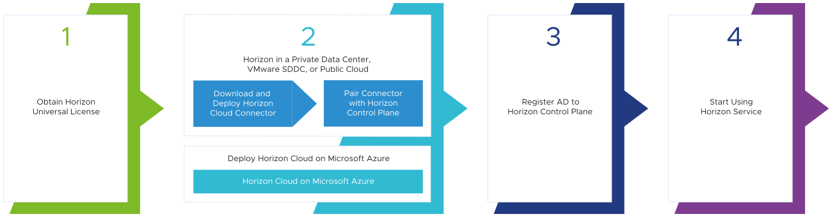
Horizon Cloud Pod Deployment Wizard
Notes:
https://docs.vmware.com/en/VMware-Horizon-Cloud-Service/index.html

Slide 80
Horizon Cloud Pod Deployment Wizard
Capacity – Where to add
On-premise
Cloud capacity
Azure
AWS
Notes:
https://www.youtube.com/watch?v=qIWum9JtLHk&t=1790s

Slide 81
Horizon Cloud Pod Deployment Wizard
General Setup
Subscription – Use Azure subscription and app registration info
Pod Setup
Name
Location/Region
Enable HA
Networking
Workspace ONE Access

Slide 82
Horizon Cloud Pod Deployment Wizard
Gateway settings
External UAG
Enable UAG
FQDN/DNS/Routes
Certificate
Load Balancer
Public IP
Type: Basic/Standard (Standard has 3 9s SLA)
Networking
2FA

Slide 83
Horizon Cloud Pod Deployment Wizard
Wait between 45 and 90 minutes…

Slide 84
Configuration
Register Active Directory
Enter binding accounts
Desktop domain join info
Define administrators group from AD group
Upload certificate files to Pod (~10-minute process)
Create internal and external DNS records

Slide 85
Base Image
Import from image Azure gallery or custom image
Select options
GPU
Domain join
Optimize
Select Horizon Agent features
DEM agent installed by default
Wait ~10-30 minutes…
Connect via RDP, install applications, and customize
Convert to image (~10-30 minutes)

Slide 86
Create Desktop Assignments
Location/Region
Compute size
Domain join and OU
Horizon settings
Image updates settings
Power management
User assignments

Slide 87
Licensing and Cost Management
Costs
Compute
Storage
Networking
Licensing
Cost Optimization
Reservations
Auto-scaling
Notes:
https://docs.microsoft.com/en-us/azure/virtual-desktop/remote-app-streaming/total-costs

Slide 88
Compute costs
Three components of compute costs
Compute
Priced per hour of runtime
Does not accrue when deallocated
Storage
Priced per GB
Licensing
Included in cost for Microsoft based SKUs
Excluded with Hybrid Use Benefit (Requires SA)

Slide 89
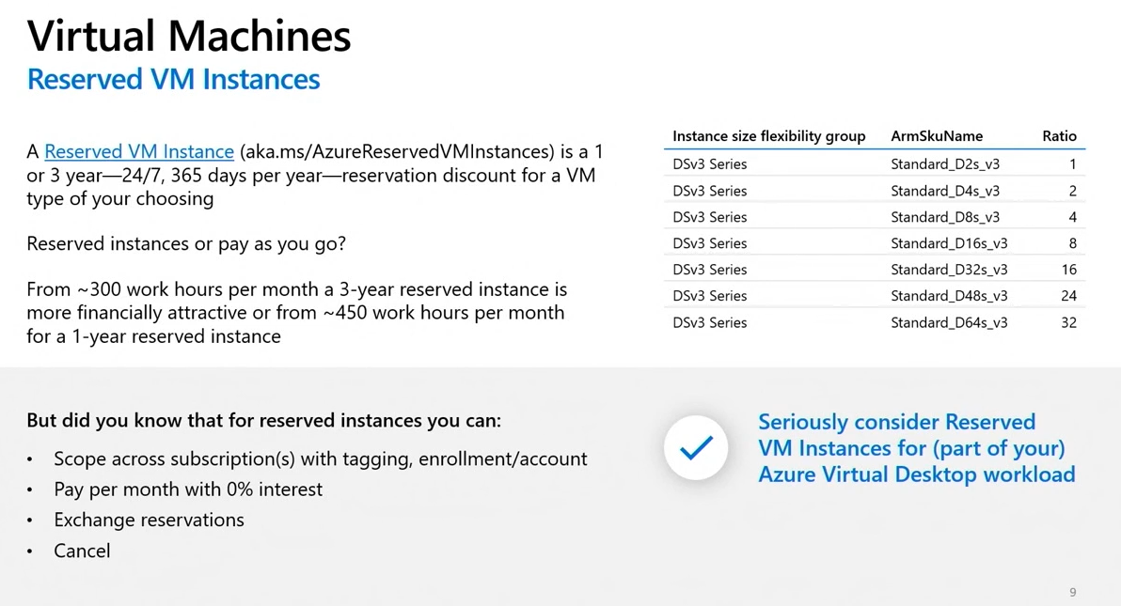
Reservations

Slide 90
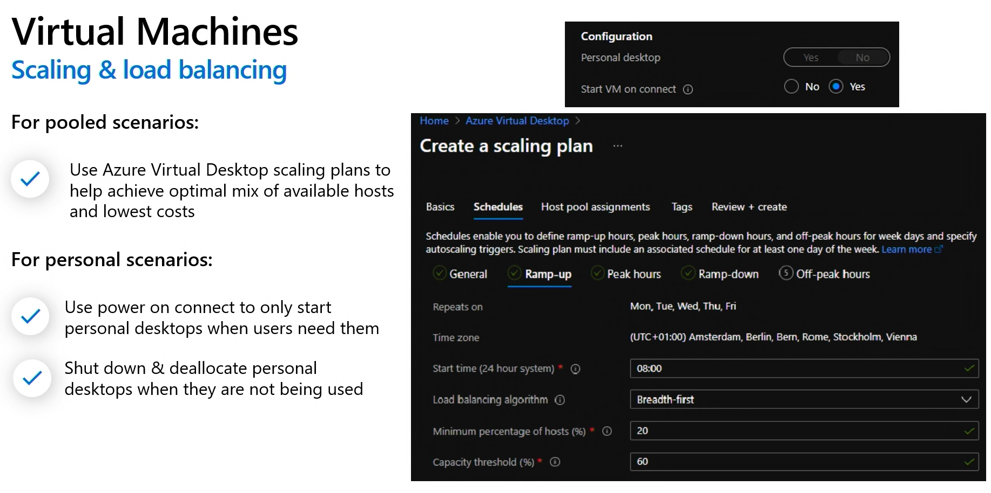
Auto-scaling & Start on Connect

Slide 91
Storage Costs
File storage
Blob < File Share
Replication for redundancy
Backup costs

Slide 92
Networking Costs
Virtual WAN
Compute
Virtual Network Gateway (VPN & ExpressRoute)
Compute
Egress
Azure Firewall
Compute
Throughput
Bandwidth
VNET peering
Egress

Slide 93
Licensing
Windows 7/10/11 single-/multi-session or app streaming
Eligible per-user license
Microsoft 365 E3/E5/F3/A3/A5/Student Use Benefits
Microsoft 365 Business Premium
Windows 10 Enterprise E3/E5
Windows 10 Education A3/A5
Windows 10 VDA per user
Monthly per user fee for external users
Windows Server
Per-user or per-device RDS CAL with active SA
Horizon Universal Subscription
Notes:
https://azure.microsoft.com/en-us/pricing/details/virtual-desktop/
https://docs.microsoft.com/en-us/azure/virtual-desktop/remote-app-streaming/licensing

